Slide 1
ICL-1302 Computer Systems

Slide 2




Desktop Computer or Mobile Device?
POWER AVAILABILITY & HEAT
AFFORDABILITY & COST
WHAT YOU USE YOUR DEVICE FOR

Slide 3
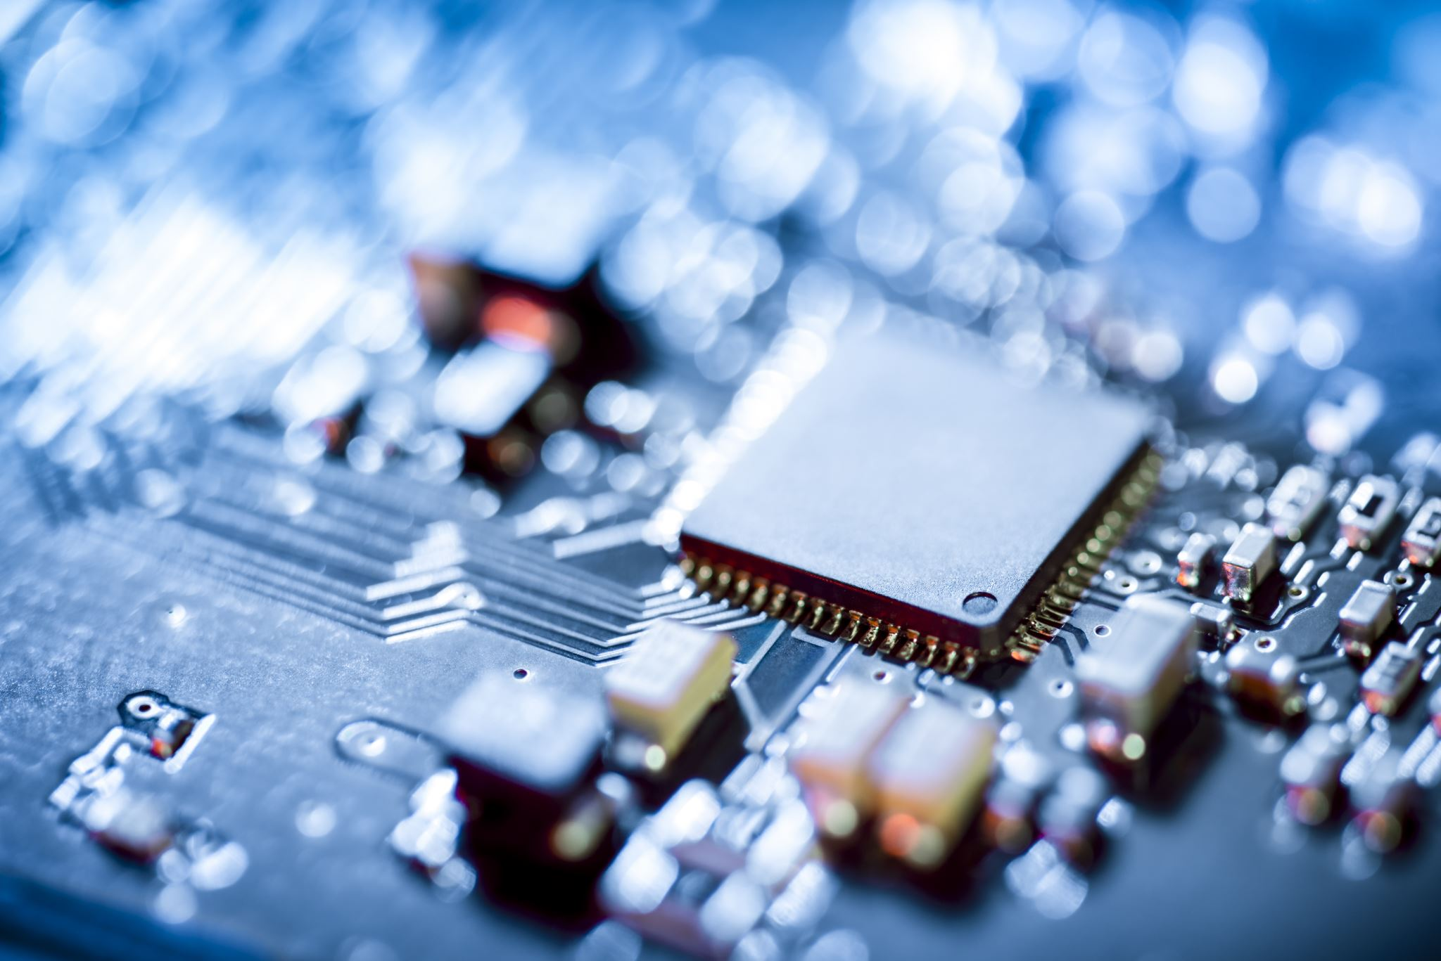
Processor
The difference between CPUs in Desktops and mobiles is not by chance, the fact is that mobiles and PCs are two totally different things [1] [2].
 | Desktop Computer | Mobile Device
Power Efficiency | Hard Wire Power Less requirements to balance power, more focus on raw compute power. | Battery Power Needs to balance efficiency over raw compute power.
Heat Dissipation | More Space More power, more heat … Desktop PC have greater cooling capacity with heatsinks and larger fans. | Less Space Need to generate less heat, less opportunity for cooling with heat sinks.
CENTRAL PROCESSING UNIT
Notes:
What’s the difference in CPUs?
Power Efficiency
Mobile devices are battery-powered and need to perform well when not connected to a power source, they need to prioritise power efficiency over raw power. Desktops lean more towards raw power over power efficiency just because they can. With laptops, high compute power simply isn’t an option, it can’t be done without burning through the battery. Even if the battery were to be able to handle it, and was connected to a power source, laptops would still opt for the power efficiency because of cooling concerns.
Heat Dissipation
Trying to get an entire Desktop into a tiny chassis is hard enough, however manufacturers also need to worry about airflow. Heat dissipation is a much slower process inside a tiny chassis, wrapped in a protective cover, held in someone's hand. With such a small amount of space, fans and available heatsinks cannot be used effectively meaning mobile CPUs need to generate less heat.
With reduced power and increased heat concerns you can expect mobile CPUs to have much lower clock speed cycles, mobile CPUs often feature fewer cores and draw less power, generating far less heat.

Slide 4
Input / Output
I/O
Is the communication between a processing system, such as a computer, and the outside world [3].
 | Desktop Computer | Mobile Device
Input | Often user inputs are using keyboards or a mouse. Limited ability to use a touch screen. | Touch based input, user input is primarily using fingers or a stylus. Less precision for smaller web links, no concept of “hovering” for web page elements. Gesturing, like swipe or pinch can be used to navigate.
Output | The obvious, a larger screen but this means generally more pixels available. Nearly all web base activity is on the internet using a browser. | Smaller screen, less pixels which is usually a decrease in image quality (gesturing helps). Whereas most of the access on mobile devices is via Apps.
 | Whilst mobile connection speeds are improving, most mobile devices can expect a download of 42mbps (upload 10mbps). Whereas broadband is double that at 80mbps download (upload 35mbps).
Statista April 23
Notes:
I/O – Input Output
Five Key Differences
Touch v’s Keyboard – Less precision, no hover for some CSS or JS classes, increased gestions (swipes, pinches, scrolling).
Screens Sizes – Resolution, pixels, smaller screen can push content out of display requiring more scrolling – Mobile sites are often designed differently.
Portrait/Landscape – Most of the time PC Monitors are in landscape, whilst mobile devices are portrait.
Browser Activity is often on the Internet when using a PC, however, according to Insider Intelligence.com 86% of online activity is spent on Apps.
Connectivity is often better with wired/WiFi connections, meaning websites with large imagines, complex JS graphics or videos can suffer from reduced download speeds.

Slide 5
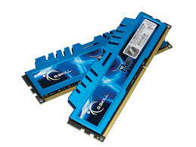
Memory
Technically both devices use the same, but there are some subtle difference [4] [5].
DESKTOP COMPUTERS
Dynamic Random Access Memory (DDR)
MOBILE DEVICES
Low-Power Double Data Rate Memory (LPDDR)
V’s
Large, requires more space, can be multi channel.
Uses more power.
Exchangeable modules for easy expansion.
Smaller, perfect for tiny chassis.
Lower Power.
Often soldered directly to the motherboard.
Notes:
SDRAM
SDRAM (synchronous DRAM) is a generic name for various kinds of dynamic random-access memory (DRAM) that are synchronized with the clock speed that the microprocessor is optimised for.
(NB. In a computer system, the clock signal is an oscillating frequency used to coordinate interaction between digital circuits. Simply put, it synchronises communication.)
DDR
Double Data Rate is a faster type of SDRAM, working with the Front Service Bus, it enables two-way data to the CPU.
LPDDR
Again, a mobile version of SDRAM. LPDDR favours 16bits rather than the 64bits used in Desktops and uses far less power making it perfect for battery powered devices.

Slide 6
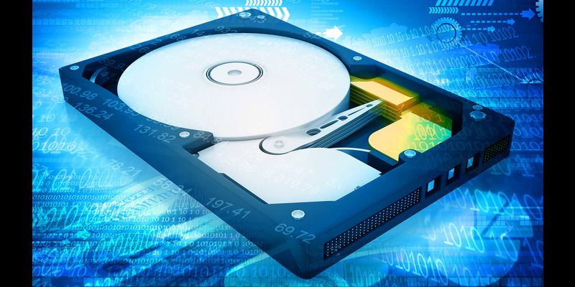
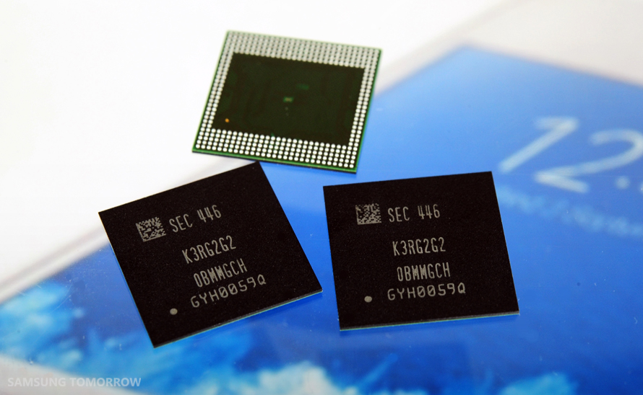
Storage
Desktops and Mobiles have different storage needs, compared with mobiles, desktops can offer great reliability, power and performance [6] [7] [8].
Desktop Computer
HDD or SSD
Cache & Controller
Mobile Device
Flash Memory
Can be slower
Notes:
Difference in Storage
Mobile phones most often use Flash Storage, Flash Storage is known as Non-Volatile meaning that data can be stored digitally, in binary form and retained even without any power.
Flash storage is a form of SSD, meaning it has no moving parts. However, Solid State Drive (SSD) do not always use just Flash Memory, most modern drives are made up of multiple flash storage that work together to operate as quickly as possible. Solid State Drives also have a component called DRAM (Dynamic Random Access Memory) this is a dedicated section of the device that operates faster than flash memory and is used to store commonly used data.
Most Desktop Computers use SSD or HDD, as flash storage still can’t beat hard disks in terms of capacity. The majority of SSDs stop around 2-4TB, while you can easily get HDDs at 10-15TB for the same price.

Slide 7
Conclusion
 | Desktop Computer | Mobile Device
Processor | Often uses more power, generating more heat and requiring greater cooling | Can struggle with heat dissipation, needs to prioritise cooling over processing power
Input/Output | Better download speeds for streaming and viewing videos and online content | 86% of activity is via Applications, less time spent on web application
Memory | 64bit channel, needs more power, can generate more heat, needs cooling | 16bit channel, uses less power, perfect where battery operation is a consideration
Storage | Separate, easy to manage, ability to add extra storage when required | Common for UFS or eMMC chips to be embedded into the device's motherboard

Slide 8

THANKS FOR LISTENING

Slide 9
References
Kimathi, G., 2022. The Difference Between Desktop and Mobile CPUs. [Online] Available at: https://www.dignited.com/75924/desktop-and-mobile-cpus/ [Accessed 3 11 2023]. [1]
Tiny Green PC.com, 2017. What is the difference between Mobile CPU and Desktop CPU?. [Online] Available at: https://www.tinygreenpc.com/blog/comparing-desktop-processor-and-mobile-processor/ [Accessed 01 11 2023]. [2]
Hart, S., 2017. Mobile vs. Desktop: 10 Key Differences. [Online] Available at: https://paradoxlabs.com/blog/mobile-vs-desktop-10-key-differences/ [Accessed 1 11 2023]. [3]
Wikipedia.Org, 2023. DDR SDRAM. [Online] Available at: https://en.wikipedia.org/wiki/DDR_SDRAM [Accessed 2 11 2320]. [4]
Wikipedia.Org, 2023. Synchronous dynamic random-access memory. [Online] Available at: https://en.wikipedia.org/wiki/Synchronous_dynamic_random-access_memory [Accessed 2 11 2023]. [5]
Pure Storage, 2023. What Is 3D NAND and How Does It Work?. [Online] Available at: https://www.purestorage.com/knowledge/what-is-3d-nand.html#:~:text=What%20does%20NAND%20stand%20for,if%20both%20inputs%20are%20TRUE. [Accessed 2 11 2023]. [6]
Wikipedia.Org, 2023. Flash memory. [Online] Available at: https://en.wikipedia.org/wiki/Flash_memory#NAND_flash [Accessed 2 11 2023]. [7]
Wikipedia.Org, 2023. Solid-state drive. [Online] Available at: https://en.wikipedia.org/wiki/Solid-state_drive#:~:text=SSDs%20based%20on%20NAND%20flash,new%20drives%20it%20takes%20longer . [Accessed 2 1 2023]. [8]

